Slide 1

J’s Finance Explorer
Student: Zih-Cin Jian (zxj161530)
Professor: Jason Parker
BUAN6340

Slide 2
J’s Finance Explorer
A web application based on an additive model for forecasting stock prices
The goal of this project:
Understand and analyze time series data
Write code and read documents and articles - python developer’s documentation, stock market terms (bear and bull) etc.
Communicate with people who have different backgrounds (see slide #8)

Slide 3
J’s Finance Explorer
Distinct differences between J’s Finance Explorer and other time-series examples used in textbooks and on the Internet listed below
Online Examples | J’s Finance Explorer
ARIMA Scikit-learn Linear Regression model Statsmodels TensorFlow (neural network computation framework) Static Dataset Quandl Online Database Basic Pandas and Numpy Basic Matplotlib | Additive Model (AM) Prophet (open source software designed by Facebook) Real-time Dataset Web Scraping Dash (a framework for building web apps) Interactive Visualization Cleaner Code(Continuous Code Refactoring) My Own Modules

Slide 4
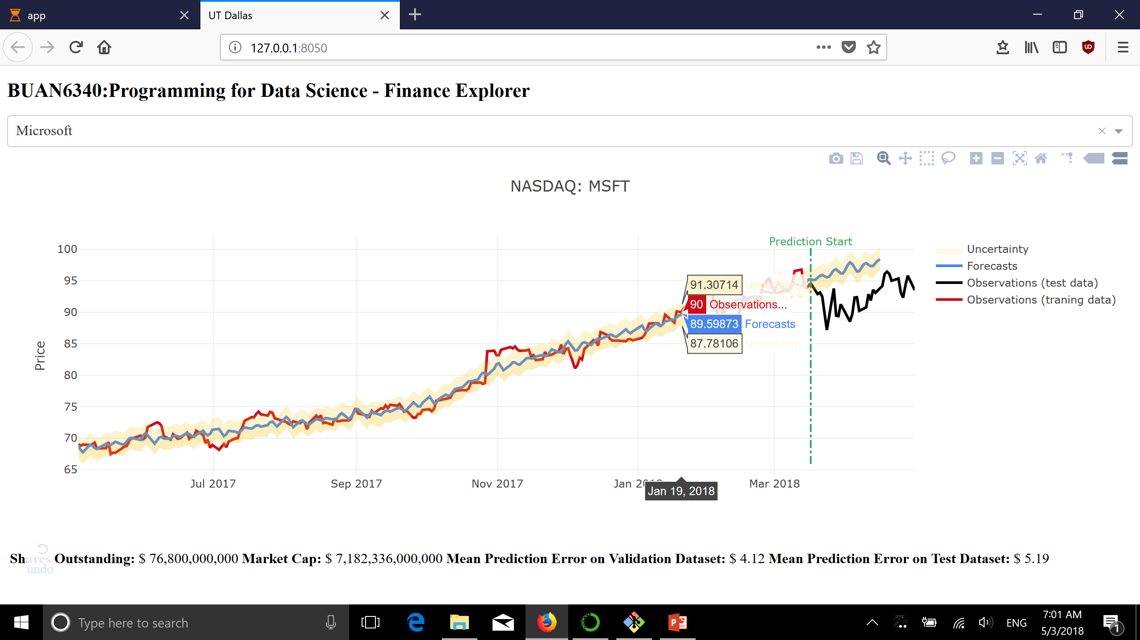
J’s Finance Explorer - Functions
Webpage
Dropdown
Menu
Tool Bar
Data Visualization
Stock Information
Model Information

Slide 5

Set up Development Environment – Atom, Auto-Complete-Python, Hydrogen, linterpycodestyle, Github
Mar 15
Mar
23
Started building Finance Explorer 1st version, using Statesmodels, Matplotlib and Quandl online database
Analyzed Stock Market Raw Data, Researched Trends and Seasonality in Time Series Data
Mar. 27
Added Real-time Data Extraction Feature & Visualized Outputs on Interactive Webpage
Apr. 20
J’s Finance Explorer
History
Apr. 30
Apr.
6
Apr. 15
Did Some Research about How to Perform Cross-Validation and Tune Parameters
Employed Prophet to Improve Model & Added Web Scraping Feature and Perform Code Refactoring
J’ Finance Explorer

Slide 6
J’s Finance Explorer – Framework
Changepoint
Prior Scale
Google Finance
(finance.py)
Time
Period
Date | Close
4/1 | $123
Training
Dataset
DS | yhat | yupper | ylower
5/1 | $145 | $146 | $143
Prophet: AM model
(stock.py)
Visualization
(app.py)
Validation
Test
Data Extraction
Shares
Outstanding
(finance.py)
Yahoo Finance Website
* Previous Close Price ≈ Market Caps

Slide 7
J’s Finance Explorer – Changepoint Prior Scale
Real time series frequently have abrupt changes in their trajectories
If these changes are being overfit(or underfit) to the model, the trend will become more(or less) flexible.
Stock | Changepoint Prior Scale | Mean Validation Error | Mean Test Error | Note
APPL | 0.05 | 10.50 | 3.57 | Probably Underfit
GOOGL | 0.05 | 47.98 | 90.14 | Probably Overfit
MSFT | 0.05 | 4.12 | 5.19 | Looks good
Evaluating changepoints was included in the previous version of J’s Finance Explorer and it was very time-consuming.

Slide 8

J’s Finance Explorer – Interesting Things You May Want to Know
You may encounter a SSL bad handshake error. I have tried to address this in many different ways such as setting SSL verify to false, but Here is the best one: reboot your laptop/pc and run app.py again
The attribute “data-*” is dynamic in yahoo finance html files. The number (e.g. data-140, data-149) assigned to “Shares Outstanding” changes every time when the page is reloaded.
The first version of stock forecast prediction model only had 50% accuracy on trend prediction. (It’s like flipping a coin, literally.)

Slide 9
J’s Finance Explorer – Things I have been asked
Q: Stock price prediction is not something new, and besides you cannot even compete against those apps designed by Google and Yahoo.
A: I think this topic is really suitable for python beginners and those who want to learn how to do analysis on time-series data. In addition, imputing missing data would take considerable time and efforts because It is not reasonable to just insert data with mean, median or zero into N/A cells.
Q: Have you consider adding NLP to analyze stock news, which would help improve your model accuracy?
A: Brilliant idea. I’d try to add this function in the near future.
Q: Kaggle is a great platform for data science, which allows you share you work with others.
A: Yes Kaggle is a nice platform and GitHub is also a good place for software developers. GitHub

